Slide 1

ION<athon>

Slide 2
team
Aayushi Mittal
MAIT
Technocrats
Geetika Thakran
GGSIPU
Simran Wadhwani
PCE

Slide 3
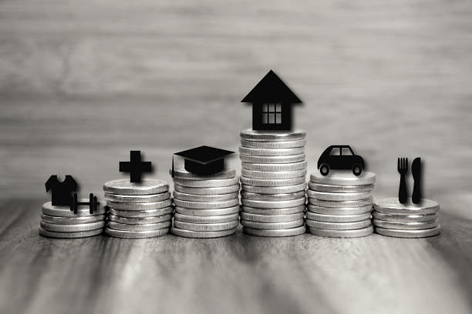
The Problem
REINVENTING LENDING

Slide 4

Problem 1
For a huge section of the Indian middle- and lower-income salaried segment, the borrowing options are few. They are forced to borrow from friends, relatives, or moneylenders at very high-interest rates as banks typically don’t cater to this segment. There is a need for an instant loan platform for the financially underserved which serves MSMEs, unbanked, underbanked,lower-and-middle income segments, etc. So far, traditional data has been being used to determine a borrower’s risk appetite.

Slide 5

Alternative data is slowly picking up pace in lending industry but lenders are yet to explore it to its full extent. There is a need to fasten the entire digital lending process and offer tailor-made solutions while mitigating risk, by leveraging different data sources and insights.
Problem 2
Consumers will need to have a higher level of financial sophistication to make effective use of financial technology (fintech) products and services, and avoid fraud and costly mistakes.

Slide 6


Meet Sarita,
A god-fearing lady of 32, who works as a part-time maid at multiple houses in a certain neighbourhood. A mother of two, Sarita is devoted to providing her children with the opportunities she never had, including an education that will help them achieve a successful future. With no formal banking history and her children’s fees to pay, Sarita is forced to head to a pawnshop and pledge her jewellery as security for a loan that comes at a staggering interest rate of 30-35%.

Slide 7

Meet Aman,
A college-going 21-year-old boy from Bhilai. He wants to improve his family's standard of living by opening a business. He opened a paper bag manufacturing unit. He sells paper bags to nearby malls and various shopkeepers. He wants to expand his business, so, he needs around 20,000 rupees.He owns a bank account but due to a lack of collateral, he is unable to get a loan from a bank. After a few days, he borrowed the amount from a local moneylender with an interest rate of about 42%. His business eventually saw a downfall due to extreme debt, and he had to shut it down.

Slide 8

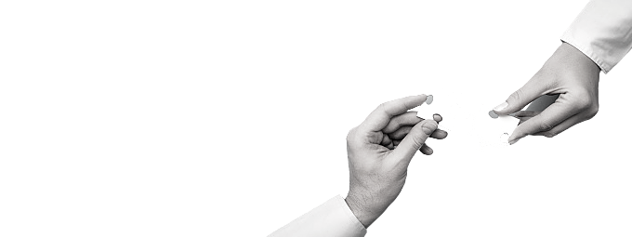
The Solution

Slide 9
Like Sarita and Aman, there are many hardworking small merchants out there who are denied loans , due to their lack of credit history, that could help them in numerous ways .
Alternative data like Aman's buisness idea and Qualification , Sarita's working hours ,Their social midea profiles,Rent Payments etc can help them get loans .
Alternative data is slowly picking up pace in lending industry .In today’s digitally native world, lenders can fasten the entire digital lending process and offer tailor-made solutions while mitigating risk, by leveraging different data sources and insights

Slide 10

Our model basically rely on data points that aren’t traditionally considered while giving loans, but that fill in important details about a borrower’s financial behavior. Examples of alternative credit data include:
Utility bill payment history
Mobile phone payment history
Cable TV bills
Rent payments
Bank account withdrawal and deposit patterns etc

Slide 11
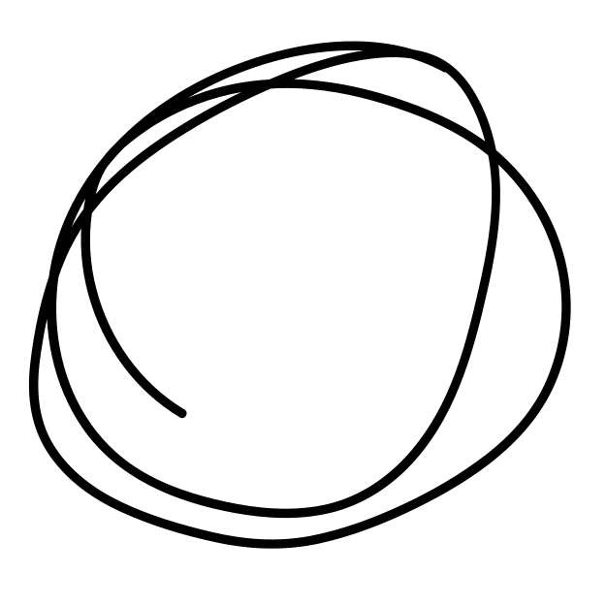
1. Loan for everyone!
Each and everyone who can complete the 2-step process will be eligible to apply for the loan.
Step 1:-Complete the KYC Process
This can easily be done with the help of an AADHAR Card in India without any additional documents.
Step 2:-Mobile number verification through OTP
A unique OTP will be sent to the mobile number for verification purposes.
The loan amount will be transferred to the user’s bank account. If a user doesn't hold a bank account, money will be sent to their mobile wallet (KYC and mobile verification done).

Slide 12
90% of people use mobile phones more than any other device. So, we aim to develop a mobile application. For the best user experience, it will be available in different languages.
2. Credit Score
It is a personal loan score given to every user. If a user repays a loan on time, his credit score will increase and he will be able to claim a loan of a higher amount in the future.

Slide 13
3. Alternative Data
Our aim is to Utilize unconventional sources of information to analyze the repayment capacity can make affordable credit accessible to the underserved.
Eg:- In the MSME category, alternative sources like PoS information, utility bill records and other fixed business expenses can offer an all-inclusive credit risk assessment and ability to curate loans.
Tasks that were earlier utterly dependent on human labour have now been assigned to computers that weed out errors and speedup processes.
All the user data will be fed to a machine learning algorithm which will predict weather user will get loan or not also it will calculate the interest rate for a particular user .

Slide 14
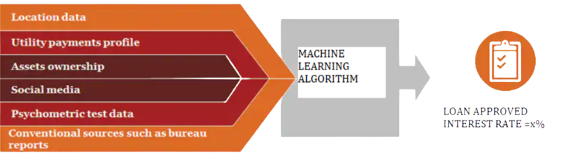
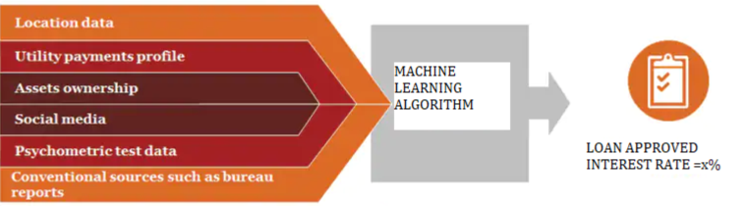

Slide 15






DURATION
SOCIAL MEDIA PROFILES
VILLAGE/
TOWN
DEVICE USAGE PATTERNS
Alternative data sources for loan approval
GROUP/SINGLE
If group loan, only one person should fill the Loan application form and invite others from Contacts .
BANKED/ OR NOT
credit history
deposit patterns
PURPOSE OF LOAN
Eduaction
Business
Health
Others

Slide 16

INCOME PROOF
ASSETS INFORMATION
BILLS (PROOF NEEDED)
Cable TV, electricity, water
Alternative data sources for loan approval
BIOGRAPHICAL INFORMATION
OCCUPATION
LOAN AMOUNT
QUALLIFICATION

Slide 17

4. Lender's Side
On the lender’s side platform is not selling the entire loan to a single investor instead it does a little bit of quote-unquote securitization where it breaks up the loan into little chunks so that idiosyncratic risks could be diluted and reduced from an investor perspective
Eg:-10,00 Rs loan will be broken up into 4 notes of 250 Rs each .
Investors/Lenders can choose to invest in different increments of 250 Rs

Slide 18
5.No Harrasement
In many cases, the apps indulge in online harassment in the form of threatening calls and messages to the person’s friends and family.
Our application prevents this in two ways:
Not disclosing the user’s personal information to lenders
By dividing the loan amount into notes as discussed in the previous step, the idiosyncratic risk will be diluted.

Slide 19

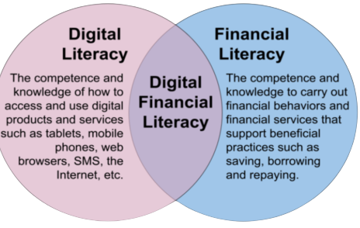
6.Digital Financial Literacy
It’s often observed that people learn by asking questions, so we will use AI Chatbot in our application so that people can ask questions about the things in which they have a dought.
Eg:- How can I apply for a loan?
Chatbot’s answer: Simply click on the "apply for loan" button after logging in.
Apart from this, the user will be informed about the interest rates, time duration, etc properly.

Slide 20

Tech Stack

Slide 21
TECH STACK
Android
JAVA , Kotlin
Machine Learning
Numpy ,Pandas,Matplotlib,Scikit-Learn
Database
90% of people use mobile phone more than any other device. So, through app this project will be more accessible to people.
Firebase, SQL
Authentication
Firebase

Slide 22
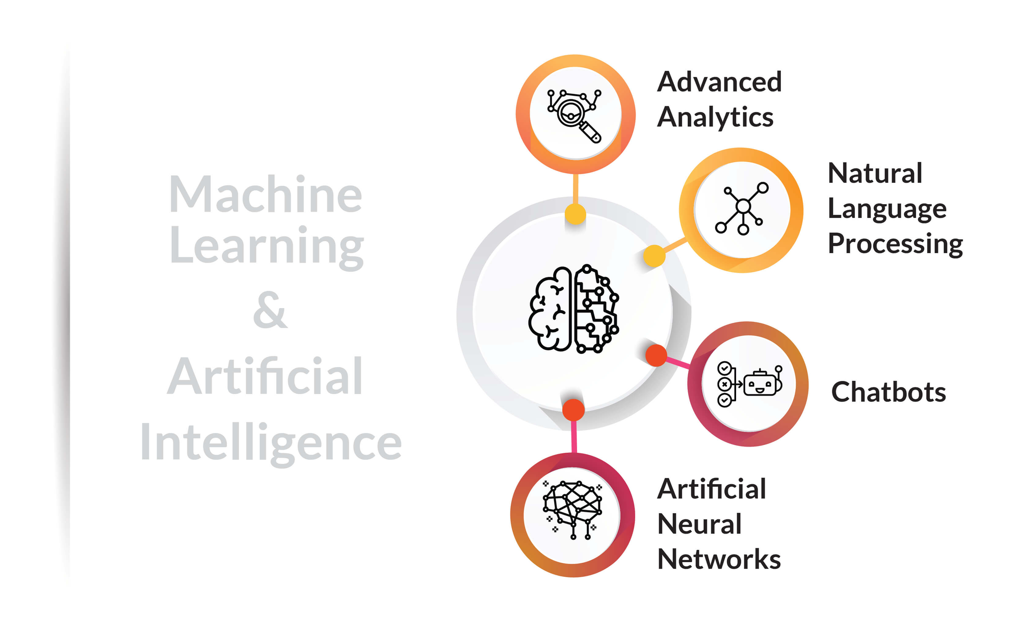
Why Machine Learning?
Easily identifies trends and patterns
No human intervention needed (automation)
Continuous Improvement-ML Algorithm gain experience, they keep improving in accuracy and efficiency

Slide 23
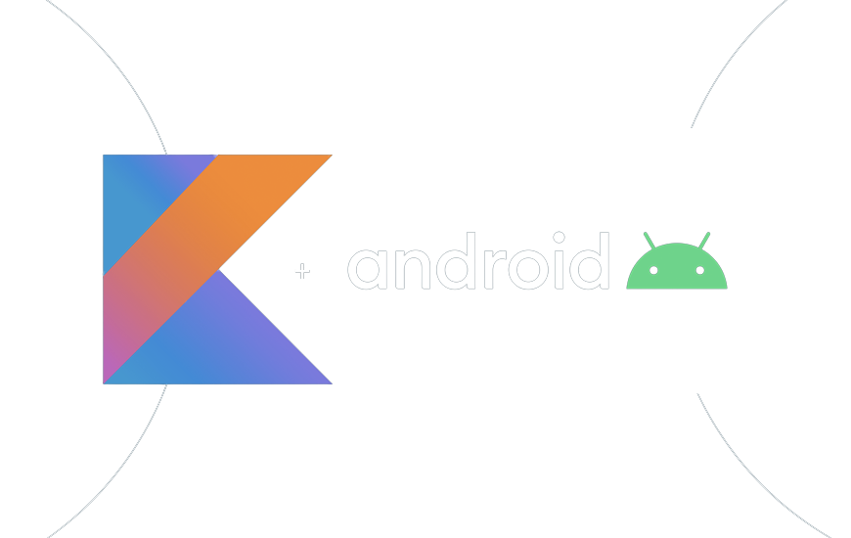


Why JAVA and Kotlin?
Reduced Source Code
Highly secure and flexible, Independent and Compatible Platform.
Open Source Development platform.
Kotlin is compatible with JAVA
Builds Robust and Secure Mobile Applications.

Slide 24
Methadology
UNDERSTANDING THE FLOW OF OUR APPLICATION

Slide 25
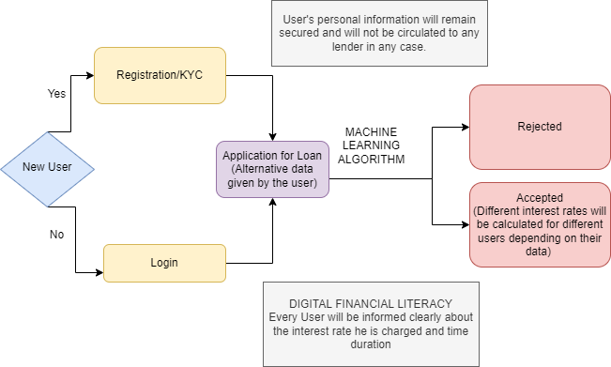
BORROWER'S SIDE

Slide 26
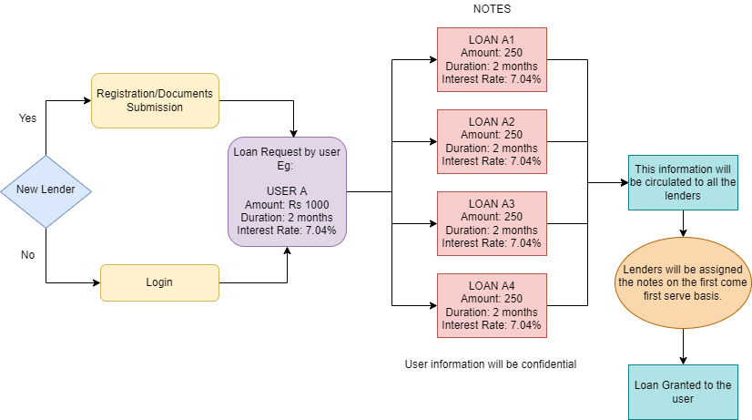
LENDER'S SIDE

Slide 27
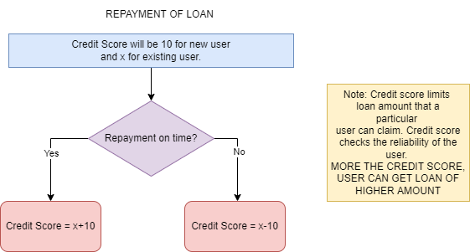
REPAYMENT OF LOAN

Slide 28
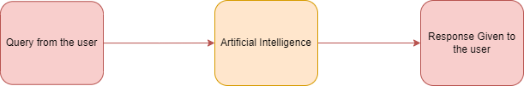
CHATBOT FLOWCHART

Slide 29
Architechture
Diagram

Slide 30
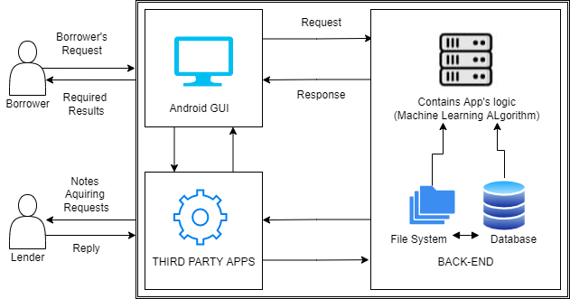

Slide 31
Scalability

Slide 32
Scalability / Usability
Scalable Machine Learning aims to combine statistics, systems, machine learning, and data mining .
In the real world, where amount of data is so large, scalability of machine learning models becomes a primary concern.
For our application we will be using GOOGLE COLLAB.
Google TPU is specially designed for the distributed memory model which provides separate IP addresses and communication protocols. And also using it saves our time from dealing with the communication layer which is taken care of by the provided accelerated Linear Algebra Layer(XLA) .It can work on large amount of Data very easily ,with fast spped.

Slide 33
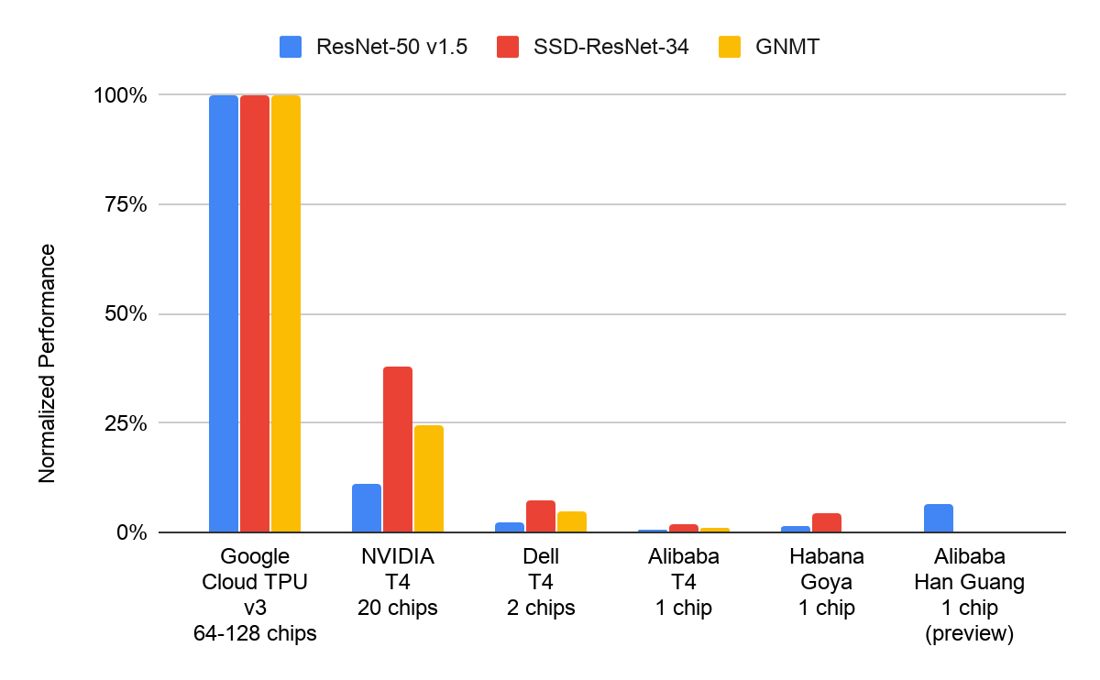
TPU -FASTEST OUT OF ALL!

Slide 34
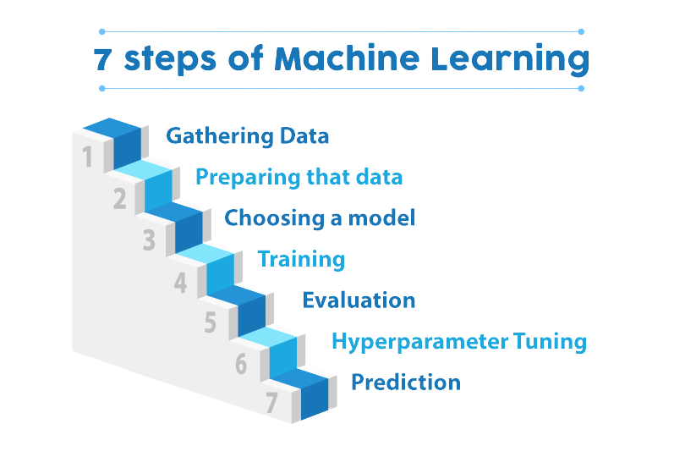
Ease of Implementing and effectiveness
If all these steps are followed in proper order then, effective Machine learning model is created. Gathering Data might be challenging in initial stages but as more data will arrive the app will perform even better

Slide 35
Social Impact/ Novelity

Slide 36
1
2
Giving loans to unbanked and underbanked population helps them to fulfill their basic
needs like education ,health, food, etc
MSME's can take loans and expand their buisnesses
3
4
"Less interest rates and no collateral "
Ultimately Borrower will be benefitted !
Assisting the most vulnerable, uneducated, low income segments of society.

Slide 37
Future Scope
WEBSITE
Building a website
MORE ALTERNATIVE DATA
More factors could be identified with time
The amount of data is also increased
MORE CREDIT LIMIT
Increasing the credit limit
MORE USER FRIENDLY
By incorporating more lanuages etc

Slide 38
THANKYOU !!

